Slide 1
Hero’s Run
Red London Games
Confidential

Slide 2
Objective
Red London Games is looking for an external production partner and publisher for its first title, Hero’s Run

Slide 3
About Red London Games
Located in Montreal
Founded in 2014 by Regis Geoffrion, a veteran of the video game industry with a proven track record and 15 years of experience
Regis has collaborated with the biggest entertainment companies in the World (Ubisoft, Disney, Warner Brothers, Nickelodeon & Electronic Arts) on new IPs and known brands
More recently at Electronic Arts, he was Executive Producer for World Series of Poker (WSOP) on both mobile and Facebook. WSOP reached a 4.5 star rating on the iOS store and generated millions of dollars in revenue annually

Slide 4
Hero’s Run

Slide 5
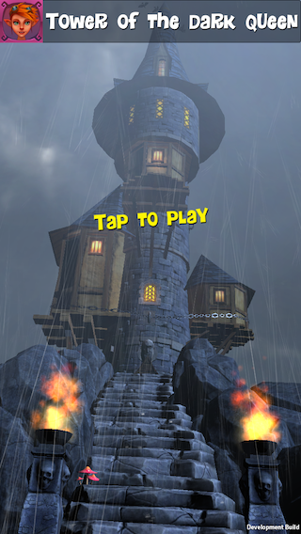
Overview
Hero’s Run is a humorous and engaging endless runner with a great cast of characters
It innovates with its unique Story mode and checkpoint system
Made in Unity
In 3D
Game universe is fantasy/fairy tale

Slide 6
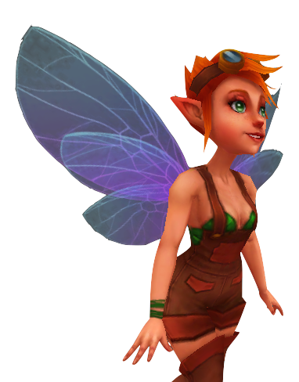
Story
The Dark Queen has used the Book of Pure Evil to cast a spell that will open the gates of Limbo
The only way to stop this catastrophic event is to banish the book to the Netherworld, but for that, you will have to run across the entire Kingdom of Lum
You are helped along the way by a courageous fairy

Slide 7
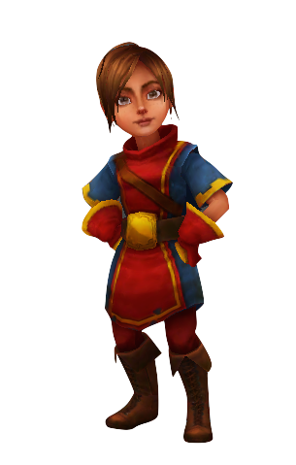
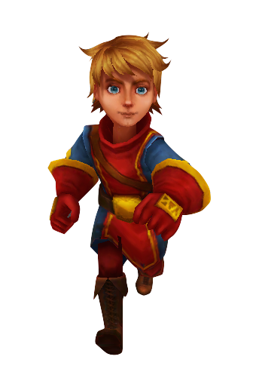
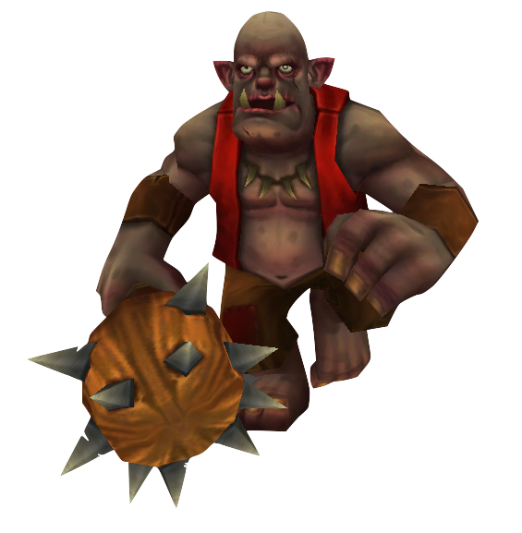
Story
The game starts off with the Hero (or Heroine, your choice) having just stolen the book from the tower
The Dark Queen sends a troll carrying a huge spiky club to chase after you and get the book back

Slide 8
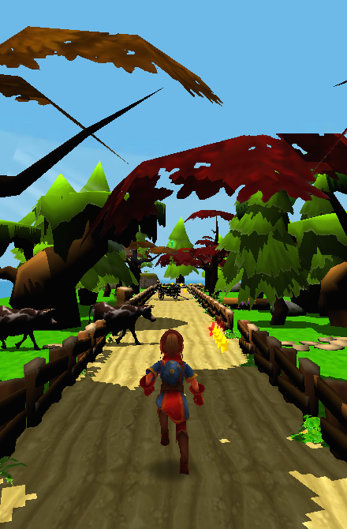
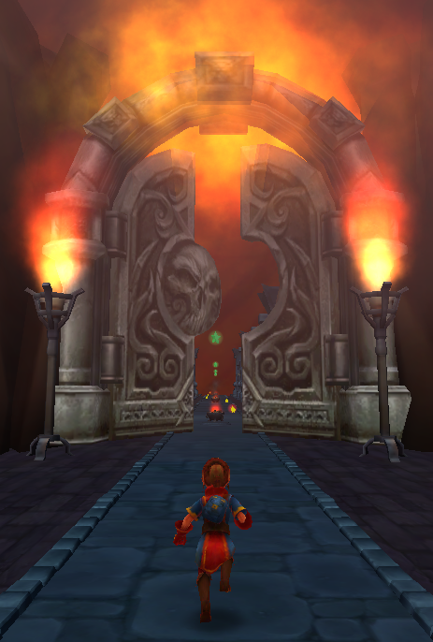
Gorgeous environments
You will travel across 4 beautiful environments in your quest to destroy the book
You start off in the bright countryside before progressing to darker environments like Dreadknot cemetery or even Hell itself
Environmental effects like lightning and rain add to your sense of adventure

Slide 9
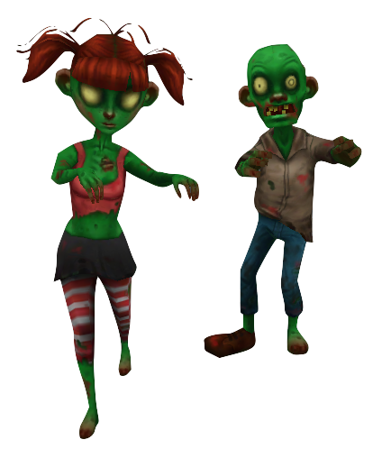

Unique obstacles
Each environment has unique and fun obstacles
In the Forest of Tanglewood, you will find cows and chickens barring your way, but in Dreadknot cemetery, you will find zombies & evil trees …

Slide 10
Saga
As you travel north across the kingdom, you will come upon checkpoints
When you die, you restart at a checkpoint. This means you do not always start from the same tedious location like in other endless runners
As you progress in the Story determined to save the world, you experience a sense of progress and adventure

Slide 11
World Map
It is a colourful map of the kingdom with fun little sprite animations
There are 18 levels in all, but more can easily be added
Each landmark and checkpoint is indicated
You can see your own progress on the World Map
What’s more, you can see the progress of your Facebook friends as well
By tapping on their image, you can send them a free Life

Slide 12
Once the Story mode is finished
You unlock additional difficulty levels: Heroic and Legendary (and get rewards and achievements)
You also unlock a more standard Endless running mode where your goal is no longer to save the World of Lum, but to get the highest score and beat your friends on the leaderboard

Slide 13
Differentiating factors
The game expands on the proven endless runner genre by adding a Story
It offers a sense of progress and achievement that can be shared with your friends
Gameplay length is bite-size–a session could be just to reach the next checkpoint
Memorable moments increase player retention
Humour will make you want to talk about the game
And who wouldn’t want to play in a wondrous world filled with zombies and fairies

Slide 14
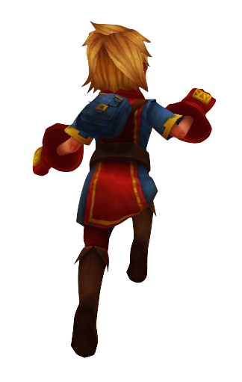
Player Controls
Swipe up to jump
Swipe down to slide. You can prolong your slide by swiping repeatedly
Swipe left or right to either:
Turn if you are in a corner or in a T-junction
Change lane otherwise

Slide 15
Player Controls
You can queue a jump. If you swipe up while jumping, when you land, you will automatically jump again
You can queue a slide. If you swipe down while jumping, when you land, you will automatically start to slide
Gravity increases if you swipe down while jumping

Slide 16
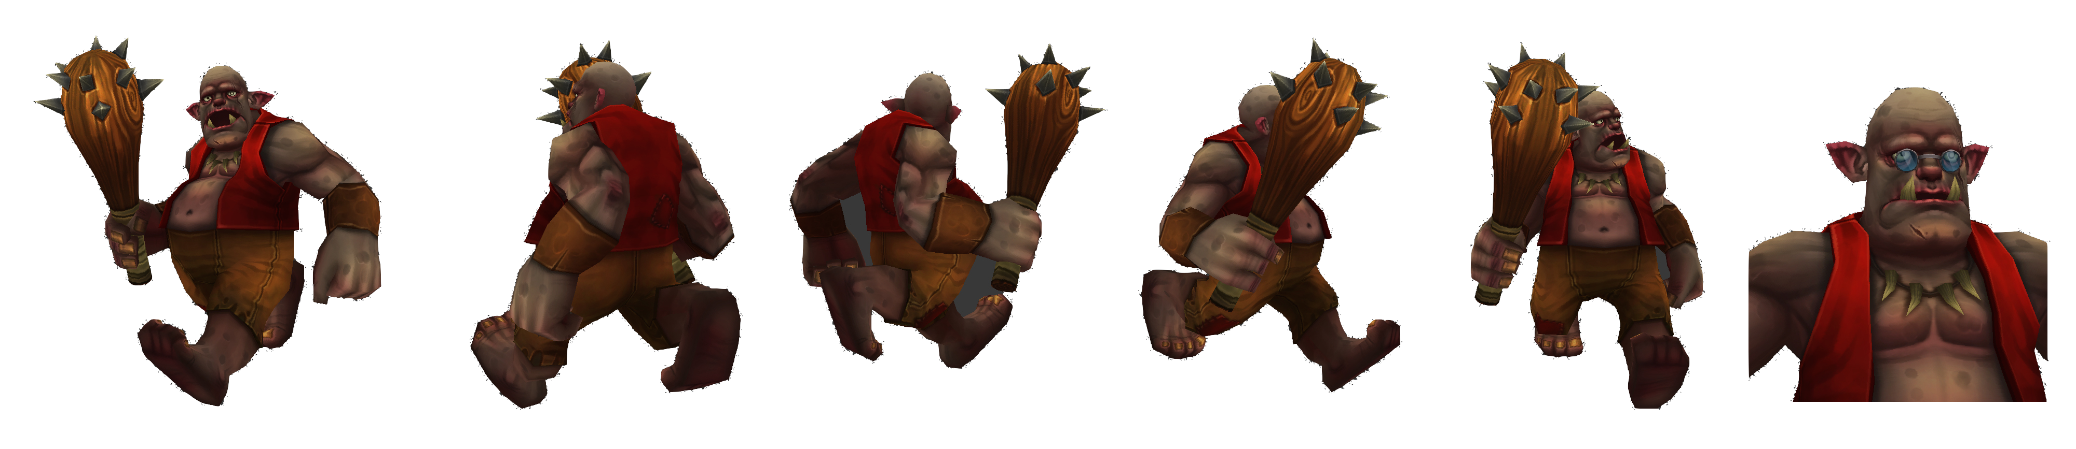
Troll
He chases the Hero during the entire game
The Hero will normally distance him quickly
If the Hero stumbles once, the troll appears behind him
If the Hero stumbles a second time while the troll is near, the troll will smash the hero with his club

Slide 17

Fairy
The world of fairies is also threatened by the Dark Queen and so she decides to help the Hero
She is the voice of the game
She is the player’s guardian angel and revives him when he dies

Slide 18

Lives
Each time you die in a level, you have the option to either:
Start the level again from your last checkpoint or
Use Lives to continue from where you died. Each time you die in the same level, the cost doubles. E.g. the first time you die, the cost is 1 Life, the second time, 2 Lives, and so on

Slide 19
Getting more Lives
To get more Lives, you can either:
Perform an IAP to buy one of the Life packs
Asks a Facebook friend for a Life
Facebook friends can send you a Life without being asked
You can find Lives in the level as your are running

Slide 20





Power-ups
Attract Stars for x seconds
Protects player against certain obstacles for x seconds
Slows down time by 50% for x seconds
Nukes all zombies within a certain radius
Allows the player to perform a double jump and catch rare stars
Most power-ups can be upgraded in the Shop (to last longer for example)

Slide 21

Virtual Currency
Stars form the virtual currency of the world
You collect Stars as you run
Star value ranges from 1(common) to a 100 (rare)
Stars can be used to:
Purchase consumable power-ups like a Z-nuke
Upgrade your power-ups
Buy passage to treasure island

Slide 22
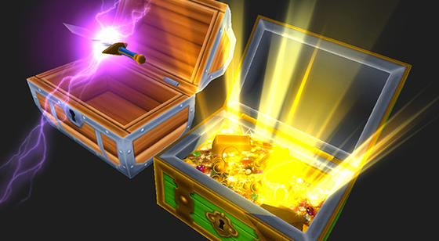
Treasure Island
This island is full of mystery chests
You need to buy passage to get there and this will give you a key allowing you to open one random chest
Some chests contain only Stars whereas other can give you consumable Power-ups, Lives and Avatar customization items (planned for phase 2)
You never know what you are going to get, which of course, is the fun part!

Slide 23
In the shop
Pack of Lives with prices ranging from $4.99 to $49.99
Pack of Stars with prices ranging from $0.99 to $99.99
Permanent Star doubler for $4.99
Passage to Treasure Island for $0.99
For phase 2, items to customize your avatar and possibly additional avatars

Slide 24
Project

Slide 25
Platforms and languages
For launch:
Platform: iOS only
Universal build
Languages: EFIGS
Post-launch:
Platform: +Android
Languages: +Japanese
Respond to feedback from the community
Additional features like avatar customization

Slide 26
Schedule
Production complete September 26
Alpha start September 29
Beta start October 20
Submission to Apple November 10
Live U.S. Thanksgiving (November 27)
Game is about 65% complete as of August 4th

Slide 27
Virality
Send friends a life (random popup when you open the game)
See how friends are progressing on the world map
Send a “postcard” on Facebook using custom stories:
“I had a hell of a day” postcard for example once player completes Hell section

Slide 28

Game center
Supports both leaderboards and achievements
Over 20 achievements tracked including fun ones like Zombie Bowling (knock down 3 zombies in less than 3 seconds)

Slide 29
Upsight Integration
Analytics (track users, IAP, retention, level completion and more)
Push notifications (for reengagement)
Announcements (To promote new game version for example)
Ads (see next slide)
More Games button (for additional revenue)
Daily Bonus of 2,000 Stars once per day (for retention)

Slide 30
Advertising
Ads are here to monetise non-payers but need to remain the least intrusive as possible
We are considering the following:
Supporting two ad networks in phase 1
Playing an ad when you launch the game
Not displaying ads before level 5
Lowering ad frequency if player has made an IAP

Slide 31
Competition KPIs
Game | Top Grossing | Top Free | Daily Revenue | Daily new users | DAU | ARPU | Annual revenue
Temple Run 2 | 273 | 32 | n/a | 20,953 | 242,724 | n/a | n/a
Subway Surfers | 66 | 22 | $18,259 | 29,547 | 371,438 | 4.91 cents | $6.6M
Despicable Me: Minion Rush | 73 | 14 | $17,293 | 44,340 | 350,155 | 4.93 cents | $6.3M
Running with friends: Free | 122 | 289 | n/a | n/a | n/a | n/a | n/a
Jetpack Joyride | 132 | 47 | n/a | 19,869 | 269,128 | n/a | n/a
Source: thinkgaming.com as of August 4th, 2014
Think Gaming estimates are currently only for the US market and iOS app store.

Slide 32
Hero’s Run – Estimated revenue
Estimate type | DAU | ARPU | Annual iOS/USA only | Annual inc. Android** | Annual inc. ROW***
Very Low | 60,000 | 3.3 cents | 722K | 975K | 1.2M
Low | 120,000* | 3.9 cents | 1.7M | 2.3M | 3M
Medium | 240,000 | 4.4 cents | 3.8M | 5.2M | 6.7M
High | 300,000 | 4.9 cents | 5.3M | 7.2M | 9.4M
Very High | 370,000 | 4.9 cents | 6.6M | 8.9M | 11.6M
* Represents 50% of current Temple Run 2 DAU
** Android revenue estimated at 35% of iOS revenue
*** Rest of World number includes revenue for iOS & Android from other countries: UK, Japan, etc. ROW revenue is estimated to be 30% of US market revenue

Slide 33
Financing
The remaining amount to complete the game is $75,000 CAD
Main items are: Level Art, some programming, UI, music & sound FX, translations, QA
Excludes marketing and user acquisition campaigns cost
A detailed breakdown of the budget is available

Slide 34
Conclusion
Hero’s Run uses a proven genre yet innovates with its story mode
It is filled with humorous and memorable moments set in beautiful fairy tale environments
The game provides a high revenue upside with minimal risk given the level of advancement of the project and the small amount of capital needed
Next step will be to play it yourself on TestFlight at the end of August

Slide 35
Thank You!

